Slide 1
HW1 – Red Wine Neural Network Classification
INF552 YUNJIE ZHAO

Slide 2
Part1 - Data
Number of Instances: | 1599
Number of Attributes: | 12
Attribute Information
Input variables | Output variable
1 - fixed acidity | quality (score between 0 and 10)
2 - volatile acidity
3 - citric acid
4 - residual sugar
5 - chlorides
6 - free sulfur dioxide
7 - total sulfur dioxide
8 - density
9 - pH
10 - sulphates
11 - alcohol

Slide 3
Part1 - Data
Attribute (units) | Min | Max | Mean
fixed acidity (g(tartaric acid)=dm^3) | 4.6 | 15.9 | 8.3
volatile acidity (g(acetic acid)=dm^3) | 0.1 | 1.6 | 0.5
citric acid (g=dm^3) | 0.0 | 1.0 | 0.3
residual sugar (g=dm^3) | 0.9 | 15.5 | 2.5
chlorides (g(sodium chloride)=dm^3) | 0.01 | 0.61 | 0.08
free sulfur dioxide (mg=dm^3) | 1 | 72 | 14
total sulfur dioxide (mg=dm^3) | 6 | 289 | 46
density (g=cm^3) | 0.990 | 1.004 | 0.996
pH | 2.7 | 4.0 | 3.3
sulphates (g(potassium sulphate)=dm^3) | 0.3 | 2.0 | 0.7
alcohol (% vol.) | 8.4 | 14.9 | 10.4
The Physicochemical Data Statistics

Slide 4
Part1 - Data

Slide 5
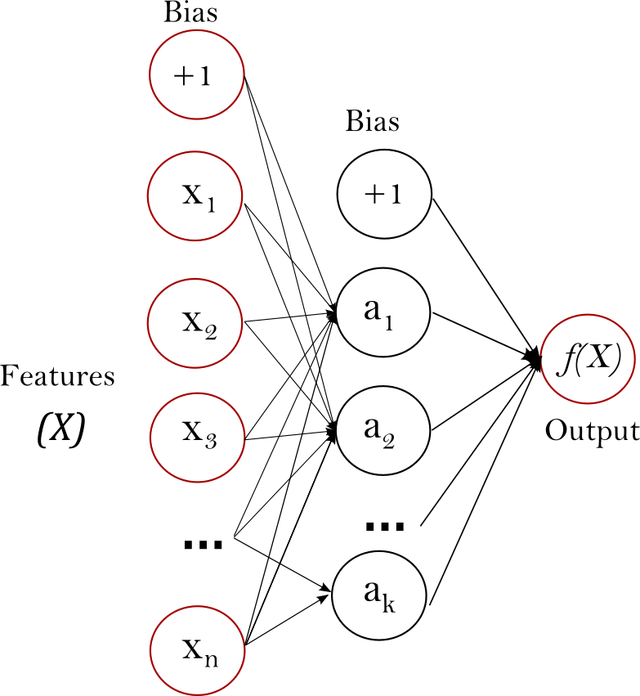
Part2 - Algorithm
Application: Scikit-Learn version 0.18
Classification: Neural Network - Multi-layer Perceptron
Given a set of features X = {x_1, x_2, ..., x_m} and a target y, it can learn a non-linear function approximator for classification
One hidden layer MLP

Slide 6
Part2 - Algorithm
Step-1 Clean Data
Deduplication
Number of Instances: 1599 reduced to 1359
Step-2 Training
MLPClassifier
a multi-layer perceptron (MLP) algorithm that trains using backpropagation.
Training Parameters: hidden layer sizes = 5, max iteration = 200
Step-3 Prediction
Test Data
Step-4 Evaluation
K-fold cross validation

Slide 7
Part2 - Evaluation
K-fold cross validation
Evaluate data with a different K(4 to 10)
In each K, do 100 random sampling. make a comparison between MLPClassication and Test data, and get a average score of 100 sampling.

Slide 8
Part2 - Evaluation
Why accuracy only is about 53%-54%?
Quality distribution ( K =5 ) (Training Size: 1088) (Test Size: 271)

Slide 9
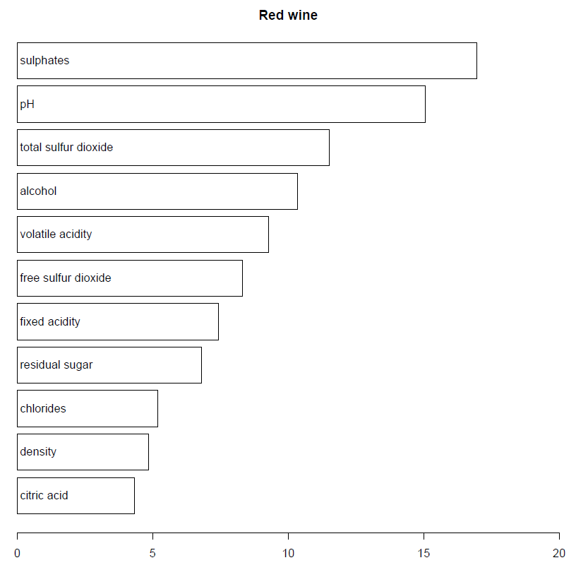
Part3 - Conclusions
Figure references from
a relevant same data paper
P. Cortez, A. Cerdeira, F. Almeida, T. Matos and J. Reis.
Modeling wine preferences by data mining from physicochemical properties In Decision Support Systems, Elsevier, 47(4):547-553, 2009.
Inputs importance

Slide 10
Part3 - Conclusions
Algorithm Analysis
Data Sampling
Training data distribution is too cohesive to be generalized
Data set is too small
Feature Engineering
11 inputs features are not relatively independence
A complex combination of too many features causes overfitting
Overfitting
Neural Network is not a simple model
We cannot observe the learning process within too many inputs, and the outputs may be difficult to explain

